Slide 1
Door Status Sign
Power, Initialization, Notes
Power
Turning It On
To turn the sign off or on, flip the switch located at the bottom-right corner on the back of the sign.
To turn the remote off or on, open the remote enclosure with the two clips on the sides. Slowly pull up the lid of the remote enclosure – do not lift by holding onto the electronic components within. There is a cable connecting the batteries to the Arduino MEGA microcontroller (the black circuit board). There is a switch connected to this cable. Flip the switch to control power.
Battery Power
The DSS remote and sign operate on two 9-volt batteries wired in parallel (the batteries supply 9 volts and double the amp-hours). If you notice that the text displayed on the LCD screen is starting to appear faded, or if the wireless range of the remote is reduced, it may be time to change the batteries.
To change the batteries of the sign, ensure that the power is first switched off with the switch in the bottom right corner of the back of the frame. Gently remove the battery clips from the heads of the 9-volt batteries present on the front of the sign. Gently press the battery clips onto new batteries and ensure they are secured with the Velcro straps.
To change the batteries of the remote, open the remote enclosure with the two clips on the sides. Slowly pull up the lid of the remote enclosure – do not lift by holding onto the electronic components within. There is a cable connecting the batteries to the Elegoo Mega microcontroller (the black circuit board). Unplug this cable. Gently remove the battery clips from the heads of the 9-volt batteries in the enclosure.
Gently press the battery clips onto new batteries and ensure they are secured with the Velcro straps.
The sign can be powered with an AC-DC power adapter that supplies 9-12VDC and 0.8-1.0 amps.
Initialization
To begin using the DSS, first switch on the remote. Then switch on the sign. Wait until the row of white squares has disappeared from the LCD display of both the remote and the sign. The remote and sign automatically connect to each other. The DSS is then ready for use.
Range
The range of the DSS remote is approximately 40 ft. This range is reduced if obstacles such as walls appear between the remote and the sign.
Components
Elegoo-brand copies of the Arduino-brand Mega 2560 Rev3 microcontroller serve as the primary “brains” of the DSS remote and sign.
The communication devices used are NRF24L01L transceivers.

Slide 2
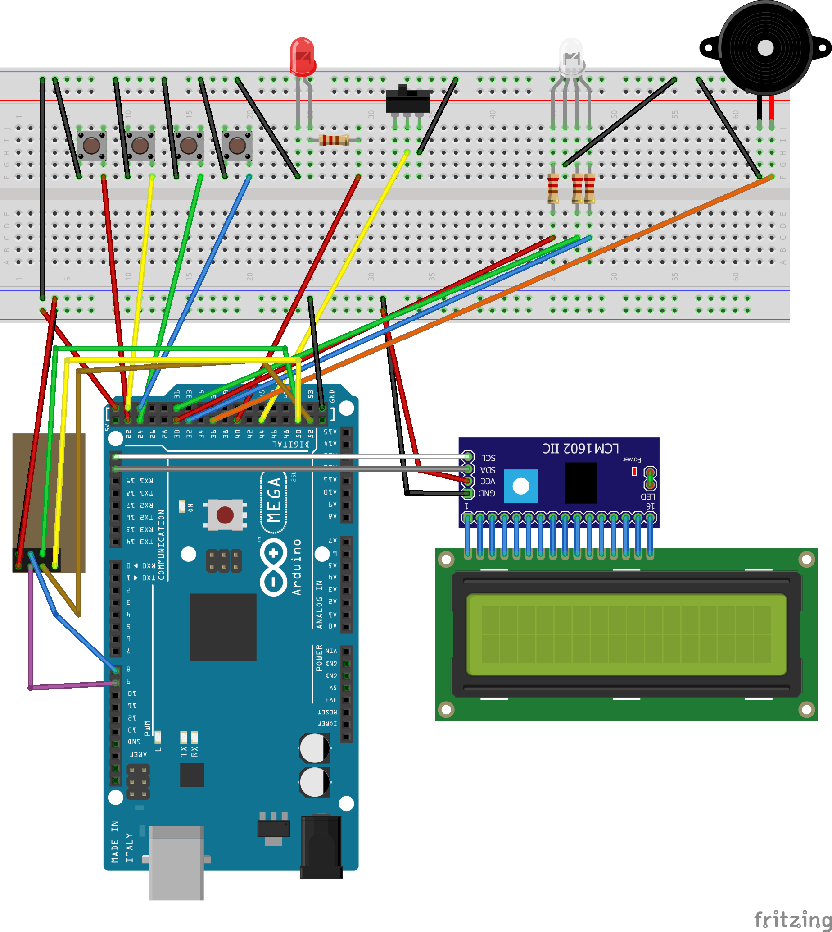
Door Status Sign
Remote Circuit Diagram

Slide 3
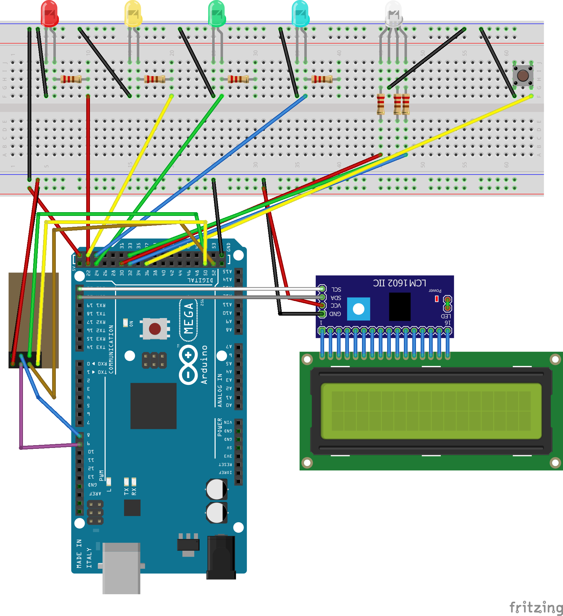
Door Status Sign
Sign Circuit Diagram

